Slide 1


USA Customs Agency - Europe
US FORCES CUSTOMS NEWCOMER’S BRIEFING

Slide 2
USA Customs Agency - Europe
Purpose
To familiarize incoming Service members, DoD personnel and Family Members with German and U.S. Customs Laws and Regulations as they apply to the U.S. Forces in Germany.

Slide 3
USA Customs Agency - Europe
NATO SOFA in Germany
Who is authorized logistic support?
U.S. Forces military personnel, members of the civilian component and their dependent family members stationed in Germany.
Please ensure that your family member dependent(s) have a SOFA card and meet all immigration requirements(Visas). This is a requirement by German law and they may face heavy fines and/or deportation.

Slide 4
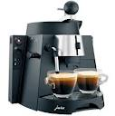





USA Customs Agency - Europe
MONTHLY RATIONS IN GERMANY
Tobacco: 4 Cartons of cigarettes
Coffee: 5lb ground or 20oz instant
Alcohol: 6.5 liters

Slide 5
USA Customs Agency - Europe
Gift giving of tax and duty free items
may only occur on special occasions
Coffee: 500 grams (17.6 oz)
Alcohol: 1.2 Liter Bottle (1 U.S. Quart)
Tobacco: 25 Cigarettes or
10 Cigars or
60 grams of Pipe Tobacco
NOTE: You cannot purchase items intended for gifts at Commissary or
Military Clothing Sales Facilities.

Slide 6
USA Customs Agency - Europe
YOUR RATIONS CARD
For your own personal use only.
Items are not for resale.
Rationed Items are not Transferable.
Violations subject to disciplinary action.

Slide 7
USA Customs Agency - Europe
PX/BX and Commissary Privileges
All items purchased in U.S. retail facilities are tax and duty free and solely for the personal use or consumption of authorized personnel.
Use of facilities by non-ID card holders is prohibited and violations will be reported to law enforcement agencies.
Misuse and/or supporting misuse of these facilities will result in disciplinary actions.

Slide 8
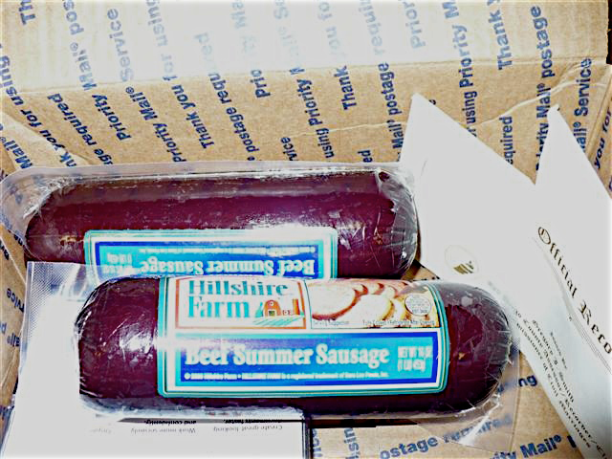
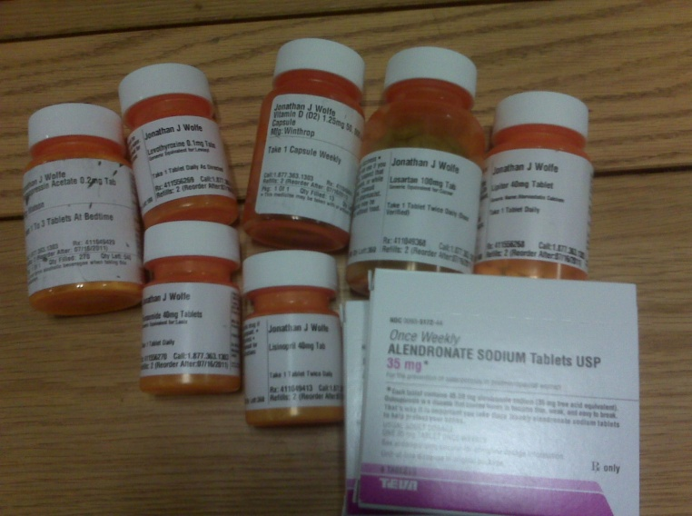

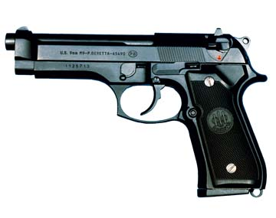

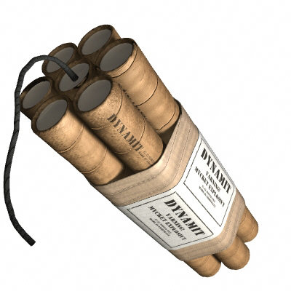
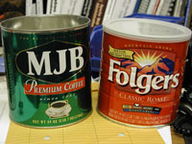

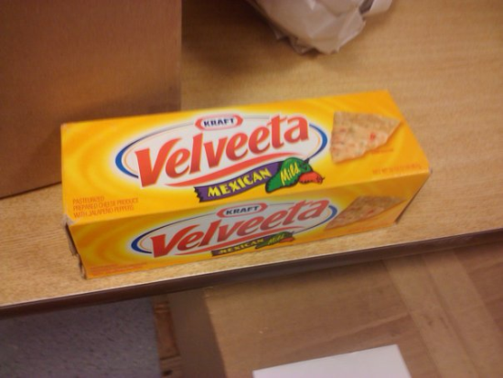
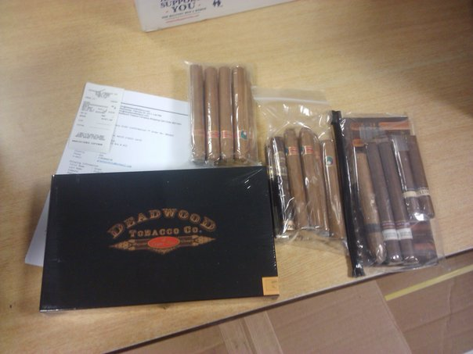
USA Customs Agency - Europe
APO-PROHIBITED/RESTRICTED ITEMS
Alcoholic Beverages
Coffee and Coffee Products
Cigarettes and other Tobacco Products
Drugs, Drug Paraphernalia and Prescription Medication
Supplements(Containing prohibited ingredients)
Firearms and Explosives
Meat, Poultry, and Milk by-product
Pornography
Pirated trademark items
Notes:
Add: Lithium Battery Shipment Prohibition APO

Slide 9





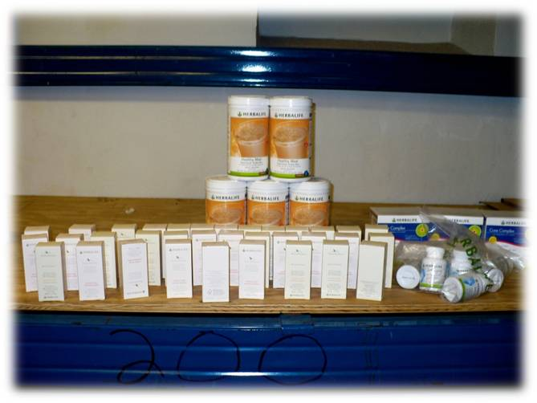
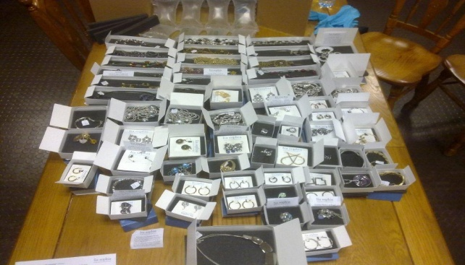
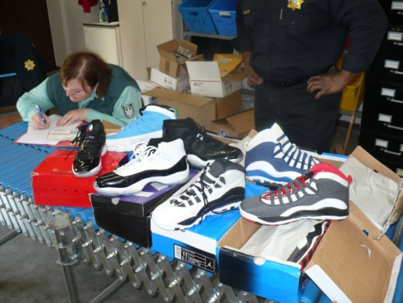
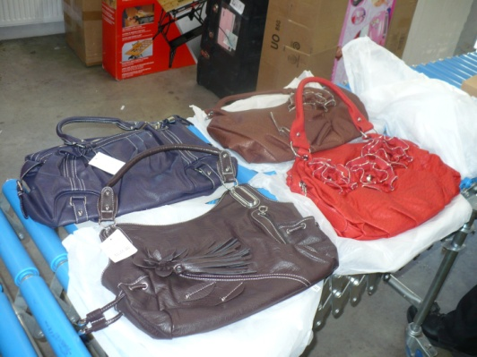
USA Customs Agency - Europe
APO-PROHIBITED ACTIVITIES
Using MPOs for commercial or business purposes or to send items intended for resale for a business or enterprise is
prohibited.

Slide 10





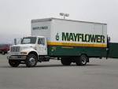
USA Customs Agency - Europe
IMPORTS INTO GERMANY Import/Export Certificate/Purchase Permit
Contact your local US Forces Customs office for any assistance for the import on any items to a German civilian address.
Note: Have in mind that before paying import duties to the delivery service, a refund is not possible!
Notes:
Before paying import duties to the delivery service. A refund is not possible!

Slide 11
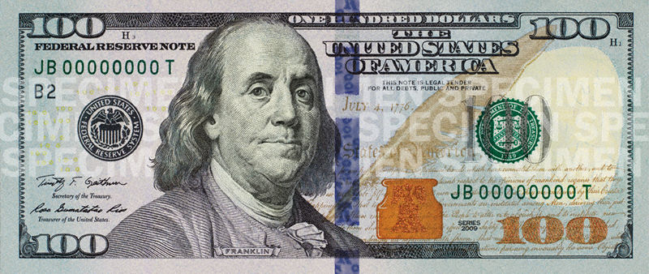

USA Customs Agency - Europe
Transferring Items to Non-ID Card
Holders
Must obtain Customs Transfer Document
To transfer personal property items imported duty-free or
purchased tax-free to non-ID card holders
ALL Vehicle sales/transfers
ALL Personally owned firearms
NOTE: Items must be in possession of seller for
at least 6 months.

Slide 12






USA Customs Agency - Europe
Authority to operate an
USAREUR plated POV
Authority to Operate a USAREUR-Plated POV by visiting non dependent family members and friends may be requested at any U.S. Forces Customs Field Office.
NOTE: Persons residing or intending to reside in Germany are NOT authorized. May not use Fuel Ration Card when re-fueling vehicle .

Slide 13



USA Customs Agency - Europe
US Forces POL Short Term
Fuel Authorization Certificate
Required Documents
German rental contract (Name of authorized person/s must be annotated on contract).
German Vehicle Registration (Green Form)
Military ID
USAREUR License or assignment orders. (Verification of Status).
Notes:
In order to obtain a L-form, the VIN must be provided. The German Vehicle Registration can be provided or some other document.

Slide 14


USA Customs Agency - Europe
US Forces Fuel Ration Card
WARNING
The ESSO fuel ration card is to be used on the vehicle it is issued for and not transferable to other vehicles. This also includes unused fuel ration.
If the allocated ration amount is exceeded; YOU will pay the local market price in euro’s. (ESSO/ AAFES)
Misuse of the fuel ration system will result in your account being blocked by US Forces Customs.
It is your responsibility to ensure that you have the appropriate amount of money in your account and fuel rations prior to filling your vehicle.

Slide 15





USA Customs Agency - Europe
Privately Owned Firearm (POF)
U.S. Forces members are prohibited from shipping or bringing Privately Owned Firearms into Germany unless they have the following:
Hunting License (Jagdschein) or Sports Shooters License (Beduerfnisnachweis)
WBK (Waffenbesitzkarte) (with each weapon entered and stamped by the German Authorities)
Importation permit (Verbringungserlaubnis) completely filled out with weapons properly entered on it.
Additional information can be obtained at Vehicle Registration Office DSN: 542-2021
NOTE: Failure to comply may result in the German authorities confiscating the POF(s) at the port of entry and charging the individual with an illegal importation of weapons or customs-related offense.

Slide 16


USA Customs Agency - Europe
Ramstein Field Office
Bldg 305 Rm 14 DSN: 480-3720/0100
Customer Service Hours of Operation
Monday – Friday
0800 -1600
Closed Weekends and U.S. Federal Holidays

